Slide 1

Data Structures Using C++ 2E
Chapter 12
Graphs

Slide 2
Objectives
Learn about graphs
Become familiar with the basic terminology of graph theory
Discover how to represent graphs in computer memory
Examine and implement various graph traversal algorithms
Data Structures Using C++ 2E

Slide 3
Objectives (cont’d.)
Learn how to implement a shortest path algorithm
Examine and implement the minimum spanning tree algorithm
Explore topological sort
Learn how to find Euler circuits in a graph
Data Structures Using C++ 2E

Slide 4
Introduction
Königsberg bridge problem
  Given: river has four land areas
    A, B, C, D
  Given: land areas connected using seven bridges
    a, b, c, d, e, f, g
  Starting at one land area
    Is it possible to walk across all the bridges exactly once and return to the starting land area?
Euler represented problem as a graph
  Answered question in the negative
  Marked birth of graph theory
Data Structures Using C++ 2E

Slide 5
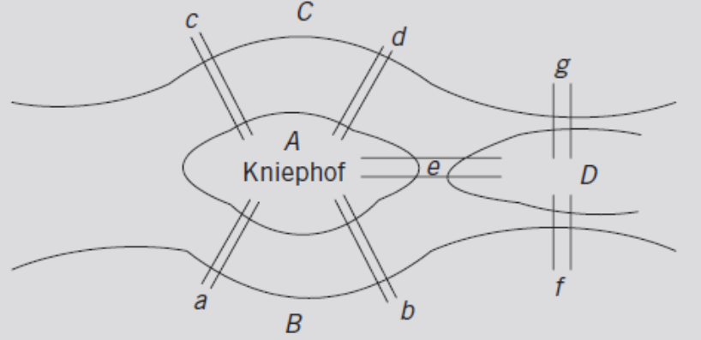
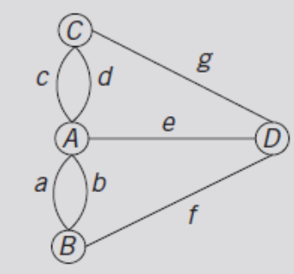
Introduction (cont’d.)
FIGURE 12-1 The Königsberg bridge problem
FIGURE 12-2 Graph representation of
the Königsberg bridge problem
Data Structures Using C++ 2E

Slide 6
Graph Definitions and Notations
Borrow definitions, terminology from set theory
Subset
  Set Y is a subset of X: Y ⊆ X
    If every element of Y is also an element of X
Intersection of sets A and B: A ∩ B
  Set of all elements that are in A and B
Union of sets A and B: A U B
  Set of all elements in A or in B
Cartesian product: A x B
  Set of all ordered pairs of elements of A and B
Data Structures Using C++ 2E

Slide 7
Graph Definitions and Notations (cont’d.)
Graph G is a pair
  G = (V, E), where V is a finite nonempty set
    Called the set of vertices of G, and E ⊆   V x V
  Elements of E
    Pairs of elements of V
E: set of edges of G
  G called trivial if it has only one vertex
Directed graph (digraph)
  Elements in set of edges of graph G: ordered
Undirected graph: not ordered
Data Structures Using C++ 2E

Slide 8
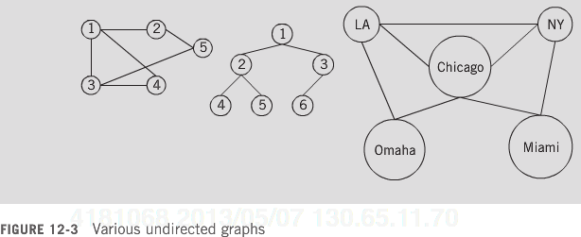
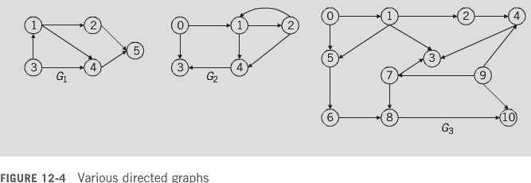
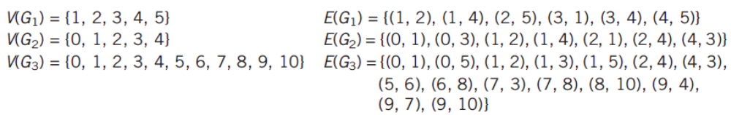
Data Structures Using C++ 2E

Slide 9
Graph Definitions and Notations (cont’d.)
Graph H called subgraph of G
  If V(H) ⊆ V(G) and E(H) ⊆ E(G)
  Every vertex of H: vertex of G
  Every edge in H: edge in G
Graph shown pictorially
  Vertices drawn as circles
    Label inside circle represents vertex
Undirected graph: edges drawn using lines
Directed graph: edges drawn using arrows
Data Structures Using C++ 2E

Slide 10
Graph Definitions and Notations (cont’d.)
Let u and v be two vertices in G
  u and v adjacent
    If edge from one to the other exists: (u, v) ∈ E
Loop
  Edge incident on a single vertex
e₁ and e₂ called parallel edges
  If two edges e₁ and e₂ associate with same pair of vertices {u, v}
Simple graph
  No loops, no parallel edges
Data Structures Using C++ 2E

Slide 11
Graph Definitions and Notations (cont’d.)
Let e = (u, v) be an edge in G
  Edge e is incident on the vertices u and v
  Degree of u written deg(u) or d(u)
    Number of edges incident with u
Each loop on vertex u
  Contributes two to the degree of u
u is called an even (odd) degree vertex
  If the degree of u is even (odd)
Data Structures Using C++ 2E

Slide 12
Graph Definitions and Notations (cont’d.)
Path from u to v
  If sequence of vertices u₁, u₂, . . ., u_{n} exists
    Such that u = u₁, u_{n} = v and (u_{i}, u_{i}+ 1) is an edge for all i =1, 2, . . ., n – 1
Vertices u and v called connected
  If path from u to v exists
Simple path
  All vertices distinct (except possibly first, last)
Cycle in G
  Simple path in which first and last vertices are the same
Data Structures Using C++ 2E

Slide 13
Graph Definitions and Notations (cont’d.)
G is connected
  If path from any vertex to any other vertex exists
Component of G
  Maximal subset of connected vertices
Let G be a directed graph and let u and v be two vertices in G
  If edge from u to v exists: (u, v) ∈ E
    u is adjacent to v
    v is adjacent from u
Data Structures Using C++ 2E

Slide 14
Graph Definitions and Notations (cont’d.)
Definitions of paths and cycles in G
  Similar to those for undirected graphs
G is strongly connected
  If any two vertices in G are connected
Data Structures Using C++ 2E

Slide 15
Graph Representation
Graphs represented in computer memory
  Two common ways
    Adjacency matrices
    Adjacency lists
Data Structures Using C++ 2E

Slide 16
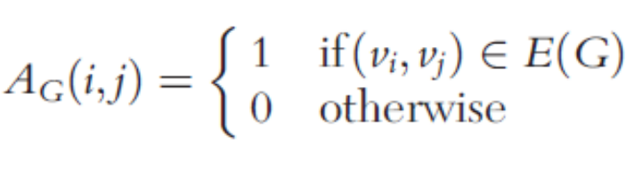
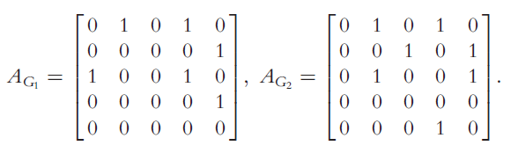
Adjacency Matrices
Let G be a graph with n vertices where n > zero
Let V(G) = {v₁, v₂, ..., v_{n}}
  Adjacency matrix
Data Structures Using C++ 2E

Slide 17
Adjacency Lists
Given:
  Graph G with n vertices, where n > zero
  V(G) = {v₁, v₂, ..., v_{n}}
For each vertex v: linked list exists
  Linked list node contains vertex u: (v, u) ∈ E(G)
Use array A, of size n, such that A[i]
  Reference variable pointing to first linked list node containing vertices to which v_{i} adjacent
Each node has two components: vertex, link
  Component vertex
    Contains index of vertex adjacent to vertex i
Data Structures Using C++ 2E

Slide 18
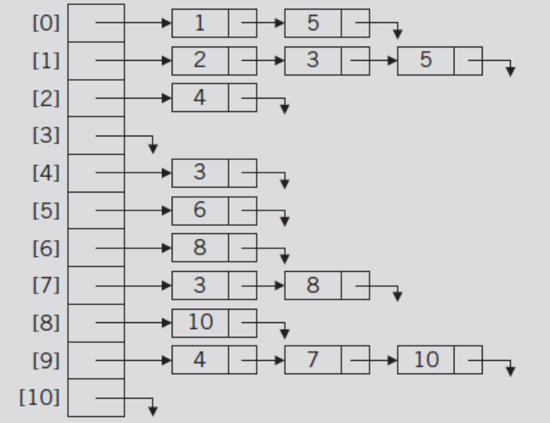
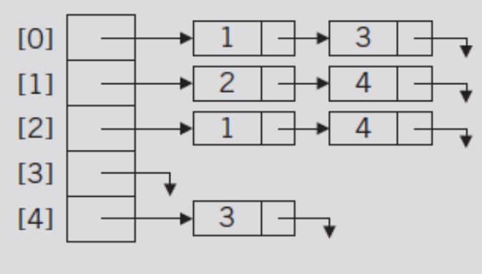
Adjacency Lists (cont’d.)
Example 12-4
FIGURE 12-5 Adjacency list
of graph G2 of Figure 12-4
FIGURE 12-6 Adjacency list of
graph G3 of Figure 12-4
Data Structures Using C++ 2E

Slide 19
Operations on Graphs
Commonly performed operations
  Create graph
    Store graph in computer memory using a particular graph representation
  Clear graph
    Makes graph empty
  Determine if graph is empty
  Traverse graph
  Print graph
Data Structures Using C++ 2E

Slide 20
Operations on Graphs (cont’d.)
Graph representation in computer memory
  Depends on specific application
Use linked list representation of graphs
  For each vertex v
    Vertices adjacent to v (directed graph: called immediate successors)
    Stored in the linked list associated with v
Managing data in a linked list
  Use class unorderedLinkedList
Labeling graph vertices
  Depends on specific application
Data Structures Using C++ 2E

Slide 21
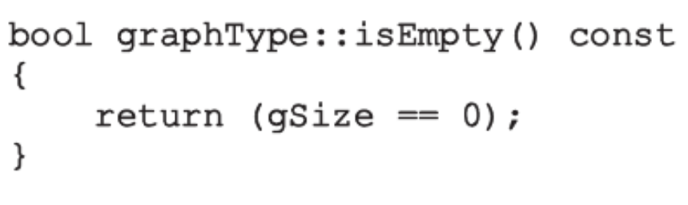
Graphs as ADTs
See code on pages 692-693
  Defines a graph as an ADT
  Class specifying basic operations to implement a graph
Definitions of the functions of the class graphType
Data Structures Using C++ 2E

Slide 22
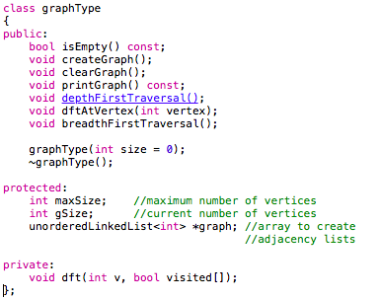
Data Structures Using C++ 2E

Slide 23
Graphs as ADTs (cont’d.)
Function createGraph
  Implementation
    Depends on how data input into the program
  See code on page 694
Function clearGraph
  Empties the graph
    Deallocates storage occupied by each linked list
    Sets number of vertices to zero
  See code on page 695
Data Structures Using C++ 2E

Slide 24
Input file of the graph
  5
  0 1 3 -999
  1 2 4 -999
  2 1 4 -999
  3 -999
  4 3 -999
Data Structures Using C++ 2E

Slide 25
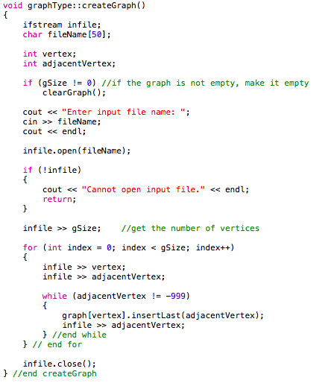
Data Structures Using C++ 2E

Slide 26
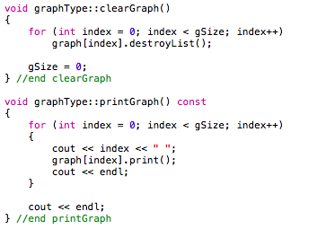
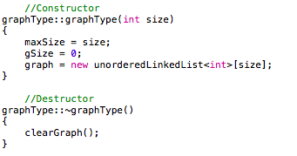
Data Structures Using C++ 2E

Slide 27
Graph Traversals
Processing a graph
  Requires ability to traverse the graph
Traversing a graph
  Similar to traversing a binary tree
    A bit more complicated
Two most common graph traversal algorithms
  Depth first traversal
  Breadth first traversal
Data Structures Using C++ 2E

Slide 28

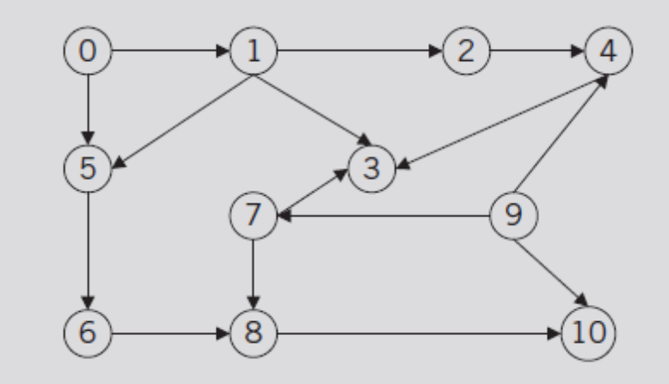
Depth First Traversal
Similar to binary tree preorder traversal
General algorithm
Depth-first ordering: 0 1 2 4 3 5 6 8 10 7 9
FIGURE 12-7 Directed graph G₃
Data Structures Using C++ 2E

Slide 29
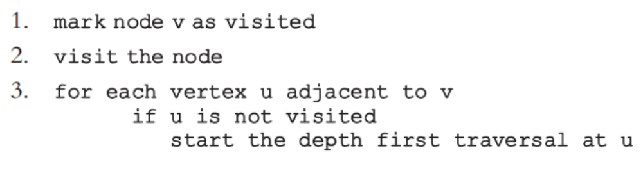
Depth First Traversal (cont’d.)
General algorithm for depth first traversal at a given node v
  Recursive algorithm
Data Structures Using C++ 2E

Slide 30
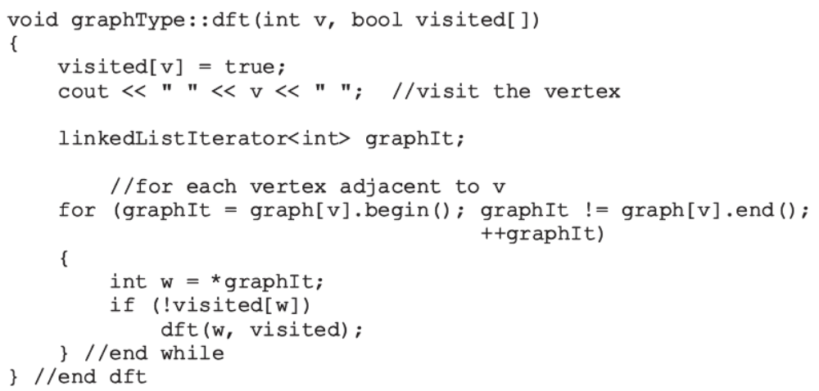
Depth First Traversal (cont’d.)
Function dft implements algorithm
Data Structures Using C++ 2E

Slide 31
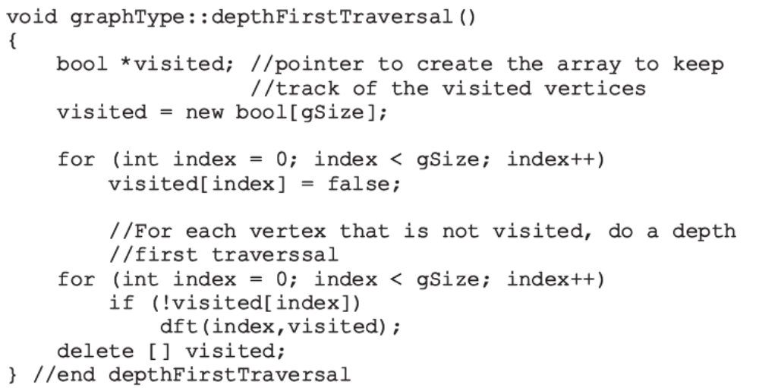
Depth First Traversal (cont’d.)
Function depthFirstTraversal
  Implements depth first traversal of the graph
Data Structures Using C++ 2E

Slide 32
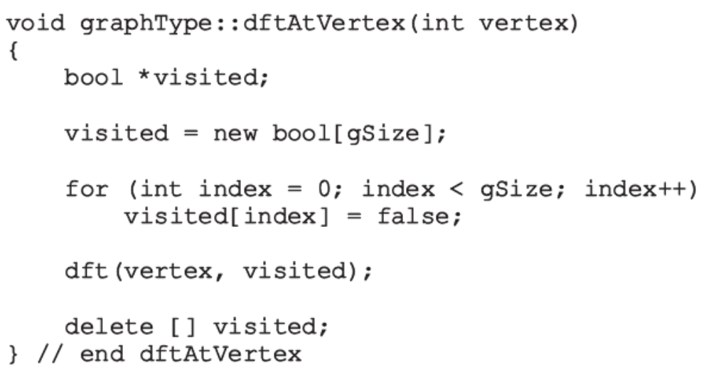
Depth First Traversal (cont’d.)
Function depthFirstTraversal
  Performs a depth first traversal of entire graph
Function dftAtVertex
  Performs a depth first traversal at a given vertex
Data Structures Using C++ 2E

Slide 33
Breadth First Traversal
Similar to traversing binary tree level-by-level
  Nodes at each level
    Visited from left to right
  All nodes at any level i
    Visited before visiting nodes at level i + one
  Breadth first ordering: 0 1 5 2 3 6 4 8 10 7 9
Data Structures Using C++ 2E
FIGURE 12-7 Directed graph G₃

Slide 34
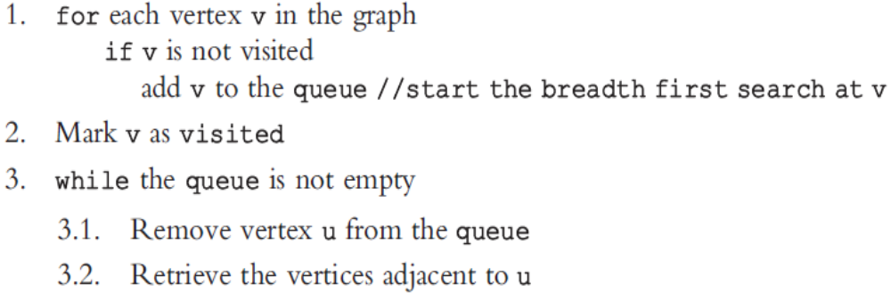
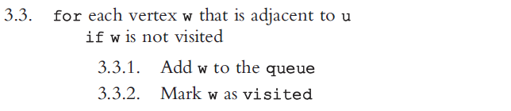
Breadth First Traversal (cont’d.)
General search algorithm
  Breadth first search algorithm with a queue
Data Structures Using C++ 2E

Slide 35
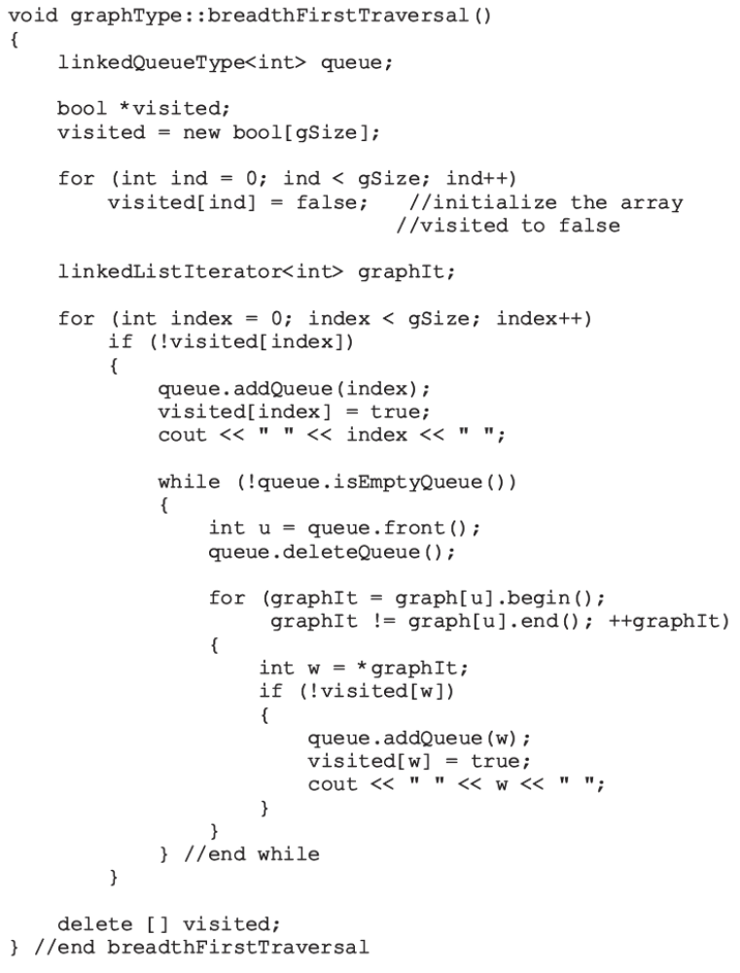
Data Structures Using C++ 2E

Slide 36
Shortest Path Algorithm
Weight of the graph
  Nonnegative real number assigned to the edges connecting to vertices
Weighted graphs
  When a graph uses the weight to represent the distance between two places
Weight of the path P
  Given G as a weighted graph with vertices u and v in G and P as a path in G from u to v
    Sum of the weights of all the edges on the path
Shortest path: path with the smallest weight
Data Structures Using C++ 2E

Slide 37
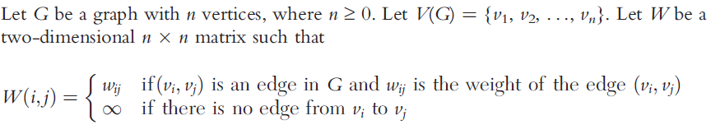
Shortest Path Algorithm (cont’d.)
Shortest path algorithm space (greedy algorithm)
See code on page 700
  class weightedGraphType
    Extend definition of class graphType
    Adds function createWeightedGraph to create graph and weight matrix associated with the graph
Data Structures Using C++ 2E

Slide 38
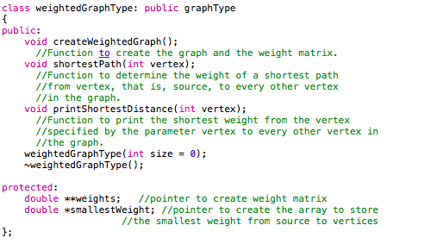
Data Structures Using C++ 2E

Slide 39
Shortest Path
General algorithm
  Initialize array smallestWeight
    smallestWeight[u] = weights[vertex, u]
  Set smallestWeight[vertex] = zero
  Find vertex v closest to vertex where shortest path is not determined
  Mark v as the (next) vertex for which the smallest weight is found
Data Structures Using C++ 2E

Slide 40
Shortest Path (cont’d.)
General algorithm (cont’d.)
  For each vertex w in G, such that the shortest path from vertex to w has not been determined and an edge (v, w) exists
    If weight of the path to w via v smaller than its current weight
    Update weight of w to the weight of v + weight of edge (v, w)
Data Structures Using C++ 2E

Slide 41
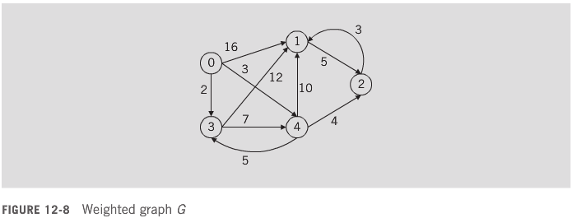
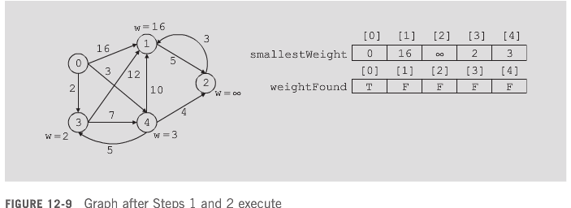
Shortest Path (cont’d.)
Data Structures Using C++ 2E

Slide 42
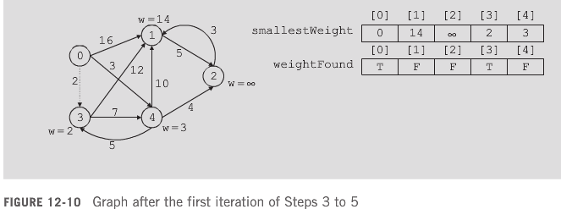
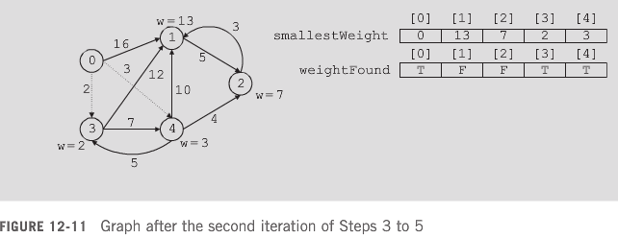
Shortest Path (cont’d.)
Data Structures Using C++ 2E

Slide 43
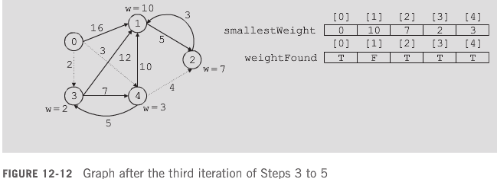
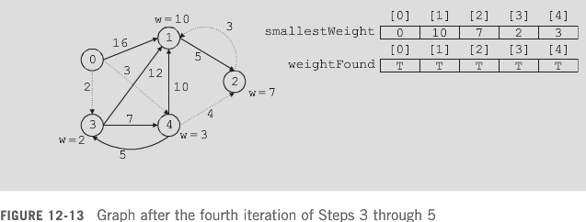
Shortest Path (cont’d.)
Data Structures Using C++ 2E

Slide 44
Shortest Path (cont’d.)
See code on pages 704-705
  C++ function shortestPath implements previous algorithm
    Records only the weight of the shortest path from the source to a vertex
Review the definitions of the function printShortestDistance and the constructor and destructor on pages 705-706
Data Structures Using C++ 2E

Slide 45
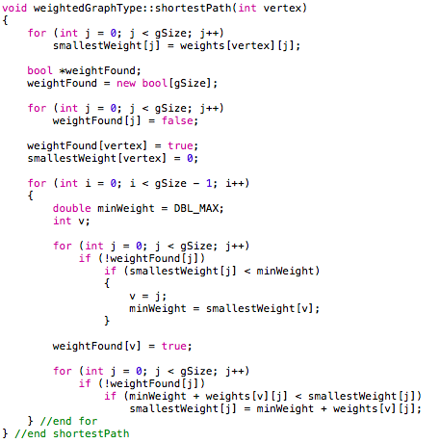
Data Structures Using C++ 2E

Slide 46
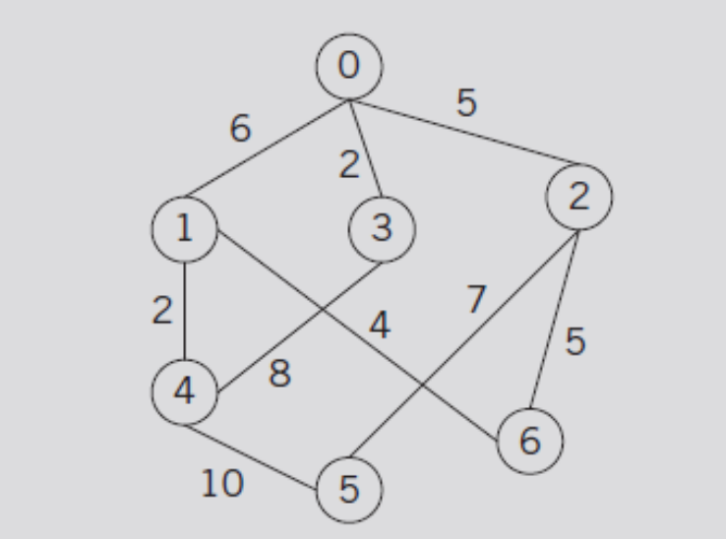
Minimum Spanning Tree
Airline connections of a company
  Between seven cities
FIGURE 12-14 Airline connections between cities
and the cost factor of maintaining the connections
Data Structures Using C++ 2E

Slide 47
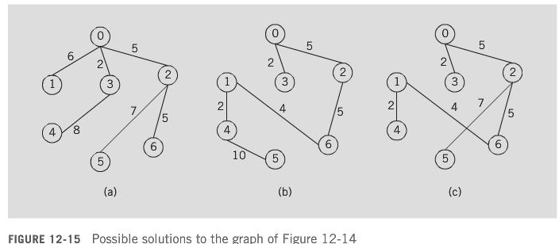
Minimum Spanning Tree (cont’d.)
Due to financial hardship
  Company must shut down maximum number of connections
    Still be able to fly (maybe not directly) from one city to another
Data Structures Using C++ 2E

Slide 48
Minimum Spanning Tree (cont’d.)
Free tree T
  Simple graph
  If u and v are two vertices in T
    Unique path from u to v exists
Rooted tree
  Tree with particular vertex designated as a root
Data Structures Using C++ 2E

Slide 49
Minimum Spanning Tree (cont’d.)
Weighted tree T
  Weight assigned to edges in T
  Weight of T denoted by W(T): sum of weights of all the edges in T
Spanning tree T of graph G
  T is a subgraph of G such that V(T) = V(G)
Data Structures Using C++ 2E

Slide 50
Minimum Spanning Tree (cont’d.)
Theorem 12-1
  A graph G has a spanning tree if and only if G is connected
  From this theorem, it follows that to determine a spanning tree of a graph
    Graph must be connected
Minimum (minimal) spanning tree of G
  Spanning tree with the minimum weight
Data Structures Using C++ 2E

Slide 51
Minimum Spanning Tree (cont’d.)
Two well-known algorithms for finding a minimum spanning tree of a graph
  Prim’s algorithm
    Builds the tree iteratively by adding edges until a minimum spanning tree obtained
  Kruskal’s algorithm
Data Structures Using C++ 2E

Slide 52
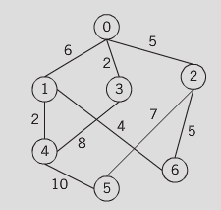
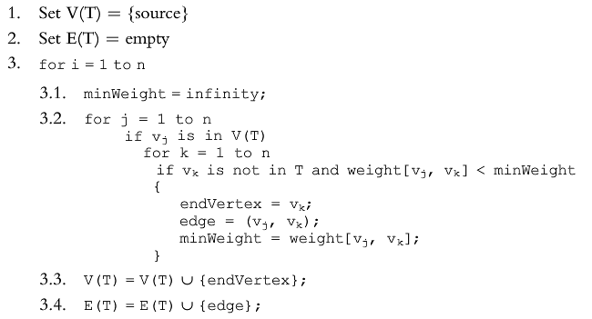
Minimum Spanning Tree (cont’d.)
General form of Prim’s algorithm
FIGURE 12-16 Weighted
graph G
Data Structures Using C++ 2E

Slide 53
Minimum Spanning Tree (cont’d.)
See code on page 710
  class msTreeType defines spanning tree as an ADT
See code on page 712
  C++ function minimumSpanning implementing Prim’s algorithm
  Prim’s algorithm given in this section: O(n³)
    Possible to design Prim’s algorithm order O(n²)
See function printTreeAndWeight code
See constructor and destructor code
Data Structures Using C++ 2E

Slide 54
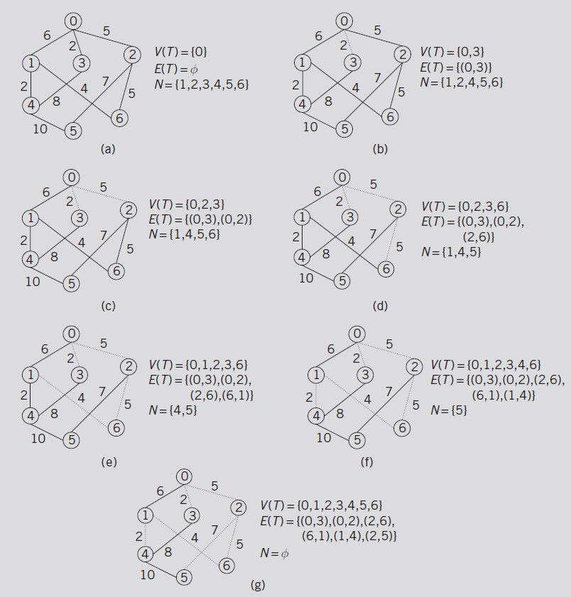
FIGURE 12-17 Graph G, V(T), E(T), and N
after Steps 1 and 2 execute
Data Structures Using C++ 2E

Slide 55
Topological Order
Topological ordering of V(G)
  Linear ordering v_{i1}, v_{i2}, . . ., v_{in} of the vertices such that
    If v_{ij} is a predecessor of v_{ik}, j ≠ k, 1 ≤ j ≤ n, 1 ≤ k ≤ n
    Then v_{ij} precedes v_{ik}, that is, j < k in this linear ordering
Algorithm topological order
  Outputs directed graph vertices in topological order
  Assume graph has no cycles
    There exists a vertex v in G such that v has no successor
    There exists a vertex u in G such that u has no predecessor
Data Structures Using C++ 2E

Slide 56
Topological Order (cont’d.)
Topological sort algorithm
  Implemented with the depth first traversal or the breadth first traversal
Extend class graphType definition (using inheritance)
  Implement breadth first topological ordering algorithm
    Called class topologicalOrderType
  See code on pages 714-715
    Illustrating class including functions to implement the topological ordering algorithm
Data Structures Using C++ 2E

Slide 57
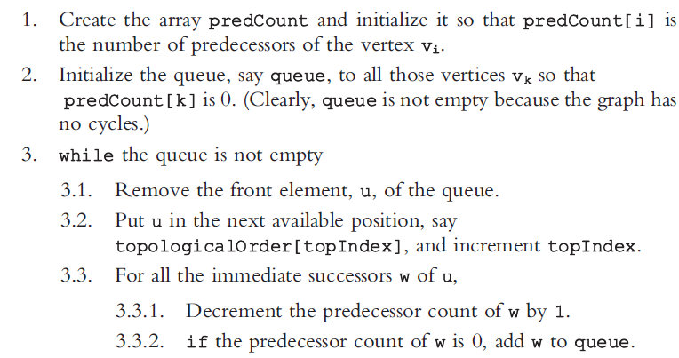
Breadth First Topological Ordering
General algorithm
Data Structures Using C++ 2E

Slide 58
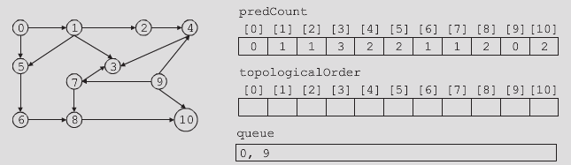
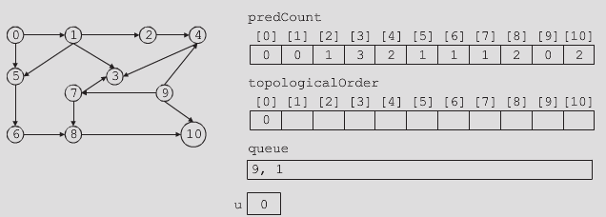
Breadth First Topological Ordering (cont’d.)
Breadth First Topological order
  0 9 1 7 2 5 4 6 3 8 10
FIGURE 12-18 Arrays predCount, topologicalOrder,
and queue after Steps 1 and 2 execute
FIGURE 12-19 Arrays predCount, topologicalOrder,
and queue after the first iteration of Step 3
Data Structures Using C++ 2E

Slide 59
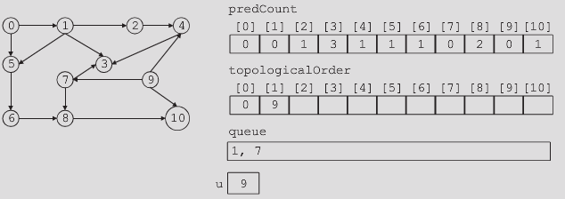
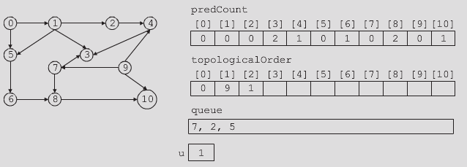
FIGURE 12-20 Arrays predCount, topologicalOrder, and queue after the second iteration of Step 3
FIGURE 12-21 Arrays predCount, topologicalOrder,
and queue after the third iteration of Step 3
Data Structures Using C++ 2E

Slide 60
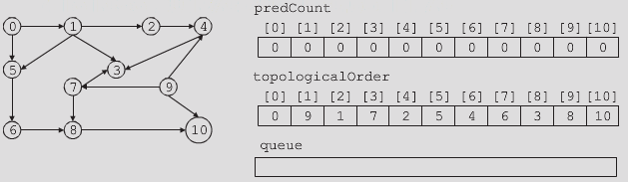
Breadth First Topological Ordering (cont’d.)
See code on pages 718-719
  Function implementing breadth first topological ordering algorithm
FIGURE 12-22 Arrays predCount, topologicalOrder,
and queue after Step 3 executes
Data Structures Using C++ 2E

Slide 61
Euler Circuits
Euler’s solution to Königsberg bridge problem
  Reduces problem to finding circuit in the graph
Circuit
  Path of nonzero length
    From a vertex u to u with no repeated edges
Euler circuit
  Circuit in a graph including all the edges of the graph
Eulerian graph G
  If either G is a trivial graph or G has an Euler circuit
Data Structures Using C++ 2E

Slide 62
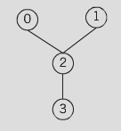
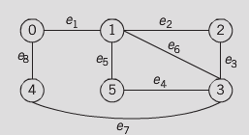
Euler Circuits (cont’d.)
Graph of Figure 12-24: Euler circuit
FIGURE 12-23 A graph with all vertices of odd degree
FIGURE 12-24 A graph with all vertices of even degree
Data Structures Using C++ 2E

Slide 63
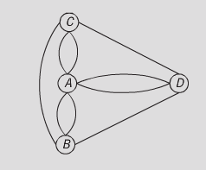
Euler Circuits (cont’d.)
Theorem 12-2
  If a connected graph G is Eulerian, then every vertex of G has even degree
Theorem 12-3
  Let G be a connected graph such that every vertex of G is of even degree; then, G has an Euler circuit
FIGURE 12-25 Graph of the Königsberg bridge problem with two additional bridges
Data Structures Using C++ 2E

Slide 64
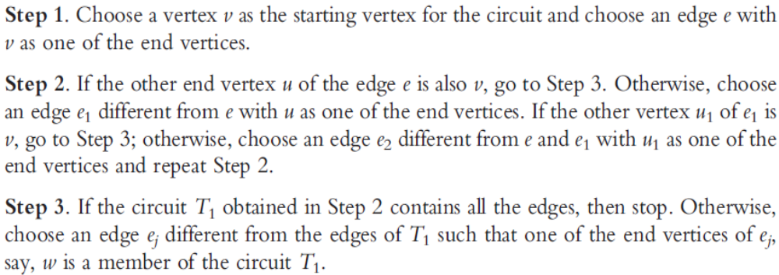
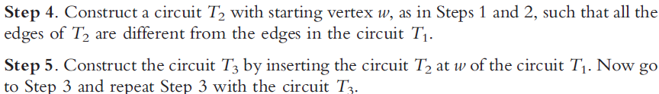
Euler Circuits (cont’d.)
Fleury’s Algorithm
Data Structures Using C++ 2E

Slide 65
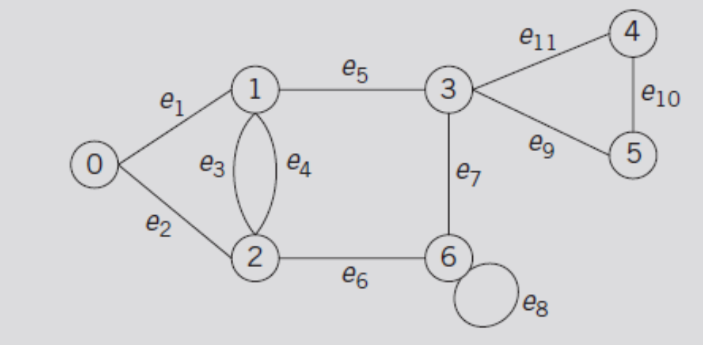
Euler Circuits (cont’d.)
Fleury’s Algorithm (cont’d.)
FIGURE 12-26 A graph with all vertices of even degree
Data Structures Using C++ 2E

Slide 66
Summary
Many types of graphs
  Directed, undirected, subgraph, weighted
Graph theory borrows set theory notation
Graph representation in memory
  Adjacency matrices, adjacency lists
Graph traversal
  Depth first, breadth first
Shortest path algorithm
Prim’s algorithm
Euler circuit
Data Structures Using C++ 2E

